Slide 1
Research Project On Extractive Text Summarization using Text Rank Algorithm
By Abhiraj Yogesh Srivastava
(Pursuing BTech in CSE from NIT Patna)
Under Supervision of
Dr. E Sivasankar Sir
Assistant Professor, CSE Dept., NIT Tiruchchirappalli

Slide 2
Text Summarization
Summarization is the task of condensing a piece of text to a shorter version, reducing the size of the initial text while at the same time preserving key informational elements and the meaning of content
There are important applications for text summarization in various NLP related tasks such as text classification, question answering, legal texts summarization, news summarization, and headline generation.
In general, there are two different approaches for automatic summarization: extraction and abstraction.
Extractive summarization picks sentences from the document based on a scoring function forming a coherent summary. This method work by identifying important sections of the text cropping out and stitch together portions of the content to produce a condensed version.

Slide 3
Collect
Collect data from online source like news articles on sports like Tennis.
Generate Summary
Break clean and filtered text into vectors and find similarity matrix using Euclidean distances, then rank these statements and generate summary.
Find Accuracy
Use Rouge Score method to find correctness of algorithm.
Split dataset into individual statements.
Split
Preprocess text by removing punctuations, numbers, special characters and stop words using Gensim library.
Preprocess
General Architecture

Slide 4
Splitting of Data Using Gensim Library
Import split_sentences() function from Gensim's summarization textcleaner library.
Split the given text into statements/sentences using the split_sentences() function and keep appending the result into statements[] variable.
Now after the splitting has been done, flatten the resultant list i.e. statements[] variable to reduce its dimension.

Slide 5
Import and unzip GloVe and extract Word Vectors
GloVe is a word vector technique that leverages both global and local statistics of a corpus in order to come up with a principled loss function which uses both these.
So we import 822.42 mb file of GloVe from the internet and unzip it.
Next we extract word vectors from statements and store them in statement_vectors variable using coefficients(coefs).
The number of vectors come out to be 400000 for this dataset.

Slide 6
Preprocessing of Data Using Gensim library
We import relevant functions from Gensim's parsing.preprocessing module to remove punctuations, numbers and special characters from the splitted text. Initialize clean_statements[] variable to store the preprocessed text.
First, strip_non_alphanum() function is used to remove all characters which are not digits or letters. Then, strip_numeric() function is used to remove numbers from the previous result. Finally, strip_punctuation() function is used to remove the rememant punctuation marks from the text. Lastly, the above processed text is converted to lowercase using lower() function and appended to clean_statements[].
Then using remove_stopwords() library function, filtered_statements[] is formed from cleaned_statements[] by removing all the stop words like and, is, the etc. Content words like adjectives, nouns, and verbs are often not considered stop words.

Slide 7
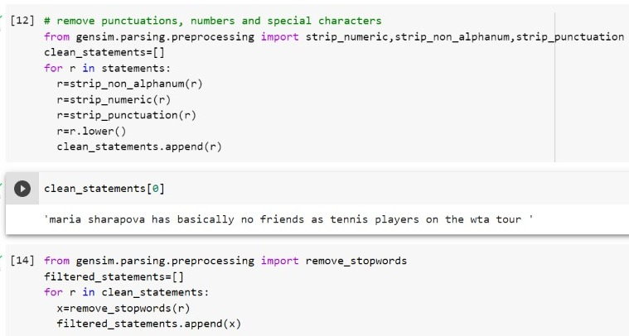
Preprocessing of Data Code Snippet

Slide 8
Finding word vectors
To load the pre-trained vectors, we must first create a dictionary word_embeddings = {} that will hold the mappings between words, and the embedding vectors of those words.​
We need to loop through each line in the file, and split the line by every space, into each of its components.​
After splitting the line, we assume that the word does not have any spaces in it, and set it equal the first (or zeroth) element of the split line.
Finally, we can update our dictionary with the new word and its corresponding vector.

Slide 9
Fetch vectors from processed text
Initialize a list named statement_vectors[] to store the fetched words from the processed text dataset(tennis dataset). The processed statements are already stored in clean_statements[] variable.​
We need to loop through each line in the clean_statements[] list, and split the line by every space, into each of its components.​
Fetch vectors (each of size 100 elements) for the constituent words in a sentence and then take mean/average of those vectors to arrive at a consolidated vector for the sentence.

Slide 10
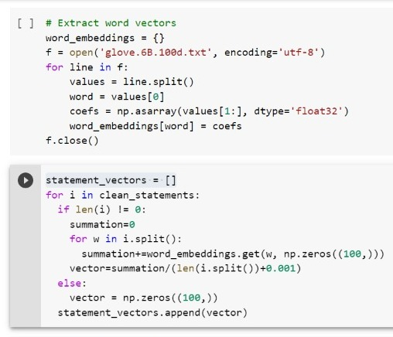
Word Vectors code snippet

Slide 11
Similarity Matrix Preparation
The next is to find similarities between the sentences, and we will use the Euclidean distance approach for this challenge. We shall first create an empty similarity matrix for this task.
Define a zero matrix of dimensions(n X n). We will initialize this matrix with Euclidean distances of the statements. Here, n is the number of sentences.
In this case, we are using Euclidean distance to compute the similarity between a pair of statements.

Slide 12
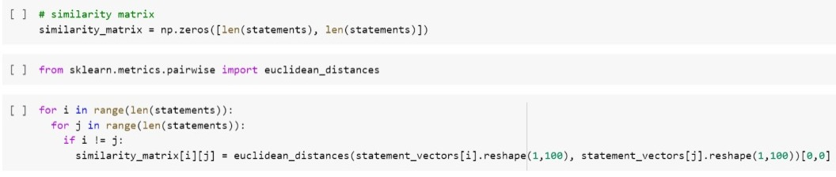
Similarity Matrix preparation snippet

Slide 13
Applying Page Rank Algorithm (Graph equivalent of text rank algorithm)
PageRank (PR) is an algorithm used to rank web pages in search engine results. It is named after both the term "web page" and co-founder Larry Page. PageRank is a way of measuring the importance of website pages.
Similarly, the textrank algorithm (keyword extraction / sentence ranking) requires as input the identification of words which are relevant in your domain.
Before proceeding further, we will convert this similarity_matrix into a graph. The nodes of this graph will represent the sentences and the edges will represent the similarity scores between the sentences.
On this graph, we will apply the PageRank algorithm to arrive at the sentence rankings.

Slide 14
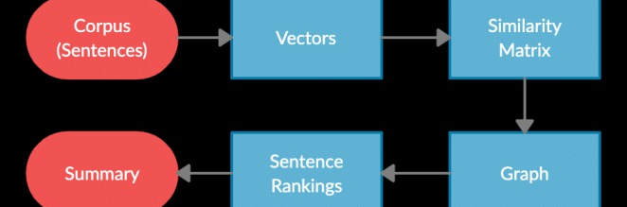
Step by Step implementation of Text Rank Algorithm

Slide 15
Summary Extraction
We sort the statements in increasing order of scores generated in the previous step.​
These statements are arranged according to their respective ranks obtained in the summary generation.
We display the top 10 sentences in the summary generated for the article_text having the article_id 7.
This output gives an idea of the final summary would look like.

Slide 16
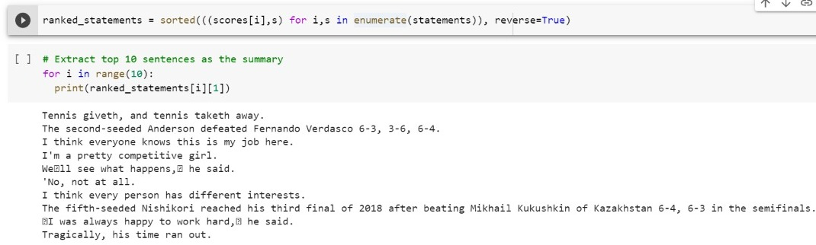
Ranked Statements of Generated Summary

Slide 17
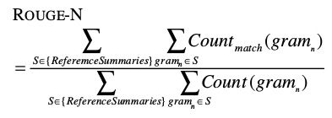
Rouge Score Calculation to find Accuracy

Slide 18
Types of Rouge Score
ROUGE stands for Recall-Oriented Understudy for Gisting Evaluation. It is essentially a set of metrics for evaluating automatic summarization of texts as well as machine translations. It works by comparing an automatically produced summary or translation against a set of reference summaries (typically human-produced). Here, we would be looking at 2 ROUGE-N scores I.e. Rouge 1 & Rouge 2 and also at Rouge l.
ROUGE-N — measures unigram, bigram, trigram and higher order n-gram overlap. For example, ROUGE-1 refers to overlap of unigrams between the system summary and reference summary. ROUGE-2 refers to the overlap of bigrams between the system and reference summaries.
ROUGE-L measures the longest common subsequence (LCS) between our model output and reference. All this means is that we count the longest sequence of tokens that is shared between both the texts.

Slide 19
Steps to find Rouge Score
We need two data sets, one original i.e. t1 and the summarized text i.e. t2. We form t1 using the ranked_statements[] and t2 by combining the 'article_text' column.
Using the get_scores() function, we find the Rouge scores- n(1&2) and l.
Here, f stands for f-score, p stands for precision and r stands for recall.

Slide 20
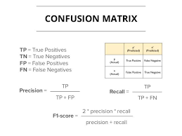
Steps to find Rouge Score

Slide 21
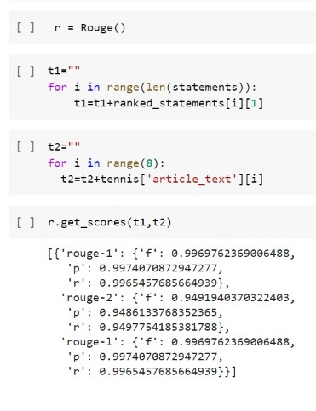
Calculated Rouge Score of TextRank Algorithm

